Slide 1

Course 2 Capstone
The OSEMN Process

Slide 2
Your Approach 1 of 4
Give at least two example questions you would want to answer as an analyst that relates to Inu + Neko’s business problem.
Remember a good question includes a focus on something that is actionable and follows the SMART goal principles (specific, measurable, attainable, relevant, & timely).
Enter your answer here:
What are the places and dates where the best and worst sales are recorded?
What type of product registers the best sales?
How has customer behavior changed over the time?

Slide 3
Your Approach 2 of 4
What information do you think would be particularly important to your analysis for Inu + Neko?
Enter your answer here:
We need to obtain the total sales for each state, as well as the average sales made for each month and day of the week.
It is also required to group the information by type of product to obtain the total earnings of each one.
Likewise, it is necessary to have the information of the new clients in each period of time

Slide 4
Your Approach 3 of 4
How would you go about gathering this information?
Enter your answer here:
This information will be collected from the csv file provided by the company. From here we will group data and obtain the necessary information

Slide 5
Your Approach 4 of 4
What are some potential issues or roadblocks can you see in trying to get this information to address Inu + Neko’s business problem?
Enter your answer here:
Some potential problems can be found in the quality of the data. It could be that the information had repeated data, too many missing data.

Slide 6
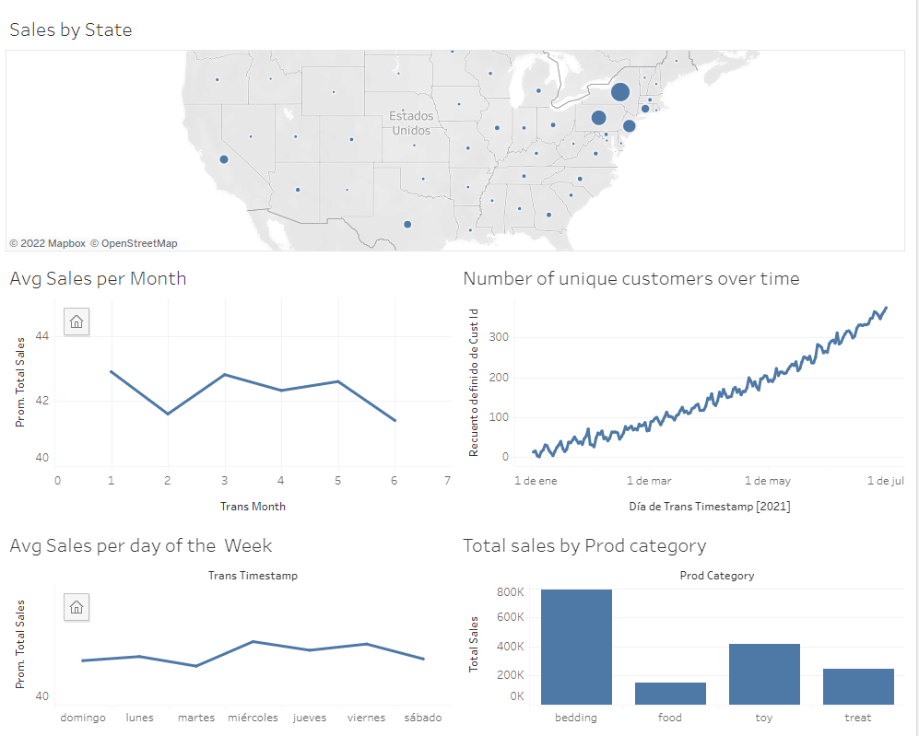
Your Data Visualization
Using Tableau, create the requested visualization (Placeholder). See Step 2 for additional instructions. The CSV is linked here.

Slide 7
Your Visualization Interpretation 1 of 2
What does this visualization show about the data?
Enter your answer here:
The dashboard tells us that there are some states where sales are notably higher. Among those that stand out are New York, Pennsylvania and New Jersey.
We can also notice that the average sales has slight decreases in the months of February and June. as well as we can notice that the average sales falls slightly on Saturday, Sunday and Monday.
The products of the "bedding" category are the ones that give the most sales, while the products of the "food" category are the ones that give the least sales.
Finally, it is important to say that the number of new users has been increasing over time

Slide 8
Your Visualization Interpretation 2 of 2
Does this visualization align with what we’ve seen so far from the data?
Enter your answer here:
Yes, this visualization is aligned with what we’ve seen so far from the data

Slide 9
Recommendations Based on Model Results 1 of 2
What recommendations would you give Inu + Neko based on the model results?
Enter your answer here:
The recommendation would be to try to focus efforts on marketing in the rest with less sales such as South Dakota or Wyoming. Likewise, focus marketing to raise the average sales, especially in the month of February, since the drop in the month of June may be since it is the last month of data registration, and it may be a month with incomplete information.
I would recommend launching promotions on weekends to boost sales and focus marketing on bedding-type products.

Slide 10
Recommendations Based on Model Results 2 of 2
What recommendations would you give Inu + Neko based on the model results?
Enter your answer here:
Based on the model, I would recommend marketing focused on people with an average age of 30 years.

Slide 11
Your Final Insights 1 of 4
What can you say about the current state of the business?
Enter your answer here:
Due to the increasing number of clients during the six months of data, I could say that the state of the business is good, it has a tendency to improve. However, the data indicates that there are growth opportunities expanding to other areas, as well as improving some of its products.

Slide 12
Your Final Insights 2 of 4
What projections can you make about the future state of the business?
Enter your answer here:
Since the states with the highest sales are located in a specific area, growth could be projected first towards neighboring states such as Connecticut or Ohio. Likewise, with the improvement of its products in less sold categories, and maintaining the quality of the products with the highest sales, a great growth of the company can be foreseen.

Slide 13
Your Final Insights 3 of 4
What would you recommend to Inu + Neko?
Enter your answer here:
I recommend starting an expansion plan into the western states. As well as improving the products of the food category. I recommend conducting surveys on these products, emphasizing what can be improved. Likewise, it is highly recommended to analyze the reason why sales drop on the weekend. Likewise, I would recommend launching a promotional campaign during the month of February, to improve sales.

Slide 14
Your Final Insights 4 of 4
What more work could be done to expand on your analysis?
(You won’t need to do this but state what would be good next steps for a follow-up analysis.)
Enter your answer here:
To expand the analysis, I would do a study on the least sold products. I would conduct surveys with an emphasis on what can be improved. It would also carry out an in-depth analysis of neighboring states to identify which is the state where efforts can be focused to improve sales. Likewise, an in-depth analysis can be carried out to find out why weekend sales decrease.

